Slide 1
FLIPROBO ASSIGNMENT 6
HOUSING PRICE PREDICTION

Slide 2
AGENDA
Problem Statement and Business Goal
EDA
​Visualizations
Steps and Assumptions
​Model dashboard
Final model
Conclusion

Slide 3
Problem statement
Problem Statement:
A US-based housing company named Surprise Housing has decided to enter the Australian market. The company uses data analytics to purchase houses at a price below their actual values and flip them at a higher price. For the same purpose, the company has collected a data set from the sale of houses in Australia. The data is provided in the CSV file below.
The company is looking at prospective properties to buy houses to enter the market. You are required to build a model using Machine Learning in order to predict the actual value of the prospective properties and decide whether to invest in them or not. For this company wants to know: • Which variables are important to predict the price of variable? • How do these variables describe the price of the house?

Slide 4
BUSINESS GOAL
Business Goal:
You are required to model the price of houses with the available independent variables. This model will then be used by the management to understand how exactly the prices vary with the variables. They can accordingly manipulate the strategy of the firm and concentrate on areas that will yield high returns. Further, the model will be a good way for the management to understand the pricing dynamics of a new market.
Technical Requirements:
• Data contains 1460 entries each having 81 variables.
• Data contains Null values. You need to treat them using the domain knowledge and your own understanding.
• Extensive EDA has to be performed to gain relationships of important variable and price.
• Data contains numerical as well as categorical variable. You need to handle them accordingly.
• You have to build Machine Learning models, apply regularization and determine the optimal values of Hyper Parameters.
• You need to find important features which affect the price positively or negatively.
• Two datasets are being provided to you (test.csv, train.csv). You will train on train.csv dataset and predict on test.csv file.

Slide 5
PRIMARY STEPS
IMPORTING LIBRARIES
import pandas as pd
import numpy as np
import warnings
warnings.filterwarnings('ignore')
GETTING THE TRAIN DATASETS AND TEST DATASETS
EDA process
df.shape
finding the shape of the dataset
df.columns
getting the number of columns
df.isnull().sum
detecting null values
df.dtypes
finding the data types of the columns
df.drop_duplicates
dropping or deleting the duplicate or repeated values

Slide 6
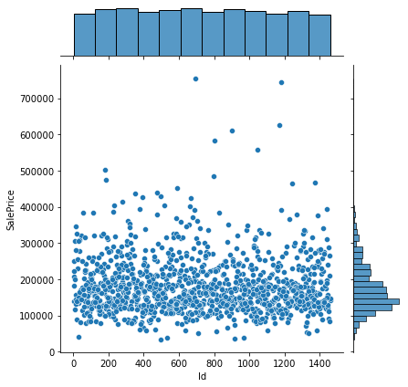
Data visualizations
Comparing the column Id with the target variable Saleprice

Slide 7
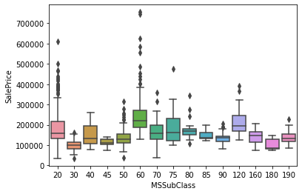
Data visualizations
Comparing the column MSSubclass with the target variable Saleprice

Slide 8
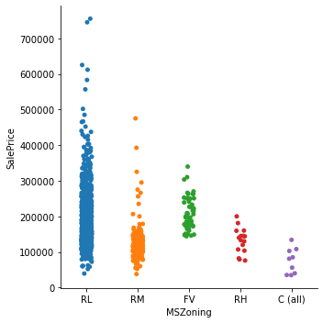
Data visualizations
Comparing the column MSZoning with the target variable Saleprice

Slide 9
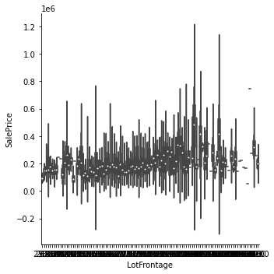
Data visualizations
Comparing the column LotFrontage with the target variable Saleprice

Slide 10
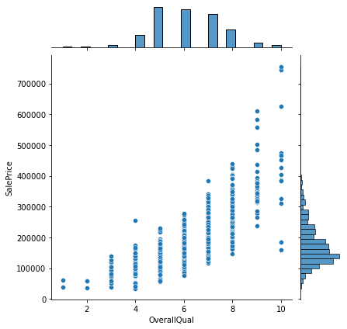
Data visualizations
Comparing the column OverallQual with the target variable Saleprice

Slide 11
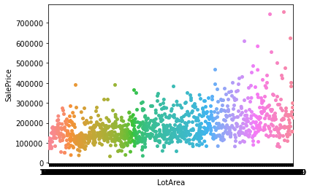
Data visualizations
Comparing the column LotArea with the target variable Saleprice

Slide 12
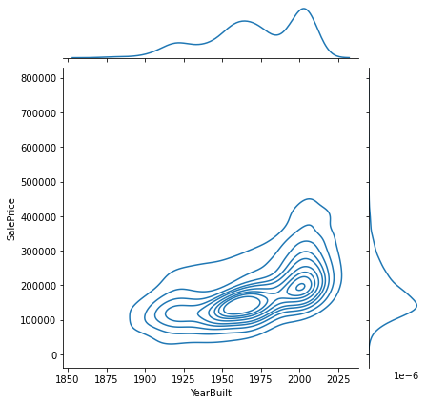
Data visualizations
Comparing the column YearBuilt with the target variable Saleprice

Slide 13
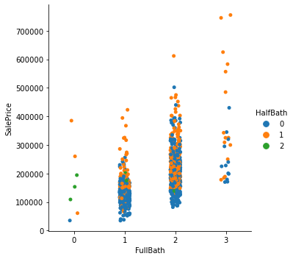
Data visualizations
Comparing the columns FullBath and HalfBath with the target variable Saleprice

Slide 14
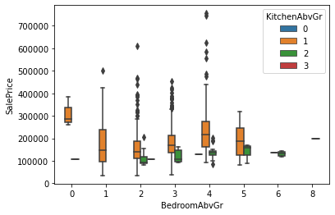
Data visualizations
Comparing the columns BedRoomAbvGr and KitchenAbvGr with the target variable Saleprice

Slide 15
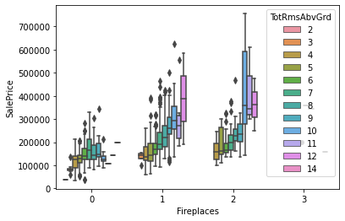
Data visualizations
Comparing the columns Fireplaces and TotalRoomAbvGr with the target variable Saleprice

Slide 16
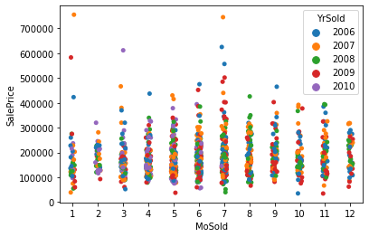
Data visualizations
Comparing the columns MoSold and YearSold with the target variable Saleprice

Slide 17
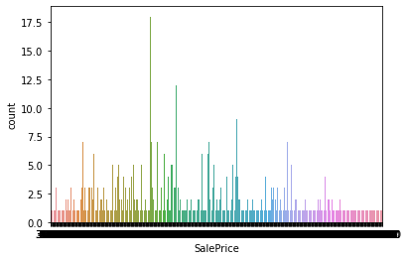
Data visualizations
Finally getting the target variable Saleprice

Slide 18
SAME STEPS FOR THE TEST DATA
EDA process
df1.shape
finding the shape of the dataset
df1.columns
getting the number of columns
df1.isnull().sum
detecting null values
df1.dtypes
finding the data types of the columns
df1.drop_duplicates
dropping or deleting the duplicate or repeated values

Slide 19
Merging both train and test datasets to get the full data
EDA process
df_merged.shape
finding the shape of the dataset
df_merged.columns
getting the number of columns
df_merged.isnull().sum
detecting null values
df_merged.dtypes
finding the data types of the columns
df_merged.drop_duplicates
dropping or deleting the duplicate or repeated values

Slide 20
EDA for merged data
Dropping few columns as it has more than 3/4 th of null values which may affect the prediction
Getting the dataset after dropping
Converting all object datas into int or float data for better processing
. Converting all null datas
. Drpping duplicate datas
. DATA CLEANSING
. Removing outliers
. Final dataset for splitting

Slide 21
Final steps
X and Y
Traing and Testing
Linear Regression
Getting the accurate random_state
Regularisation
Getting the input variables(x) and output variable (y)
Train_test_split
Since the target variable (y) contains more of float data, we consider LinearRegression for prediction
Using the steps tofind out the correct random_state
Lasso,Ridge and ElasticNet

Slide 22





Training,testing and hypertuning
Trying with different alpha parameter
Testing with various models
Hypertuning
Comparing the best three models in a dataframe
Compared to all models RIDGE model has the best r2_score, so hypertuning it
(for finding best regularization)
Tuning all models using GridSearchCv
DecisionTreeRegress KNeighborsRegresso
SVR GradientBoostingRegressor,AdaBoostRegressor,ExtraTreesRegressor,RandomForestRegressor

Slide 23



Getting,saving and reloading the best fitted model
Getting the best model(RIDGE)
Saving the best fitted model
Reloading and testing the best model

Slide 24
SUMMARY
Houses are one of the necessary need of each and every person around the globe and therefore housing and real estate market is one of the markets which is one of the major contributors in the world’s economy. It is a very large market and there are various companies working in the domain. Data science comes as a very important tool to solve problems in the domain to help the companies increase their overall revenue, profits, improving their marketing strategies and focusing on changing trends in house sales and purchases. Predictive modelling, Market mix modelling, recommendation systems are some of the machine learning techniques used for achieving the business goals for housing companies. Our problem is related to one such housing company.
After doing various steps in data analysing, data cleaning , data removing for balancing, training and testing , hypertuning we get the best fitted model for the given datasets is :
RIDGE

Slide 25
THANK YOU
from :
Name:
RAMAA DEVI S
Batch No :
INTERNSHIP34

